Slide 1


A Multi-media Approach to Cross-lingual Entity Knowledge Transfer
Di Lu, Xiaoman Pan, Nima Pourdamghani,
Shih-Fu Chang, Heng Ji, Kevin Knight
Rensselaer Polytechnic Institute, University of Southern California, Columbia University
Notes:
Add logos

Slide 2
Task
  Entity (e.g. Location, Person, Organization) discovery and linking from low resource language documents.
Situation
  Disease outbreaks, natural calamities…
Challenge
  Few language processing tools.
  Few resources such as lexicons.
  No rich representation.
  Little training data.
Possible Approach
  Projection from English Knowledge Base
  Key: comparable document retrieval
Notes:
Why ? Big events

Slide 3
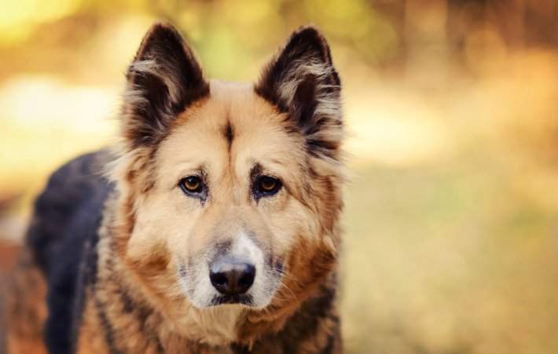
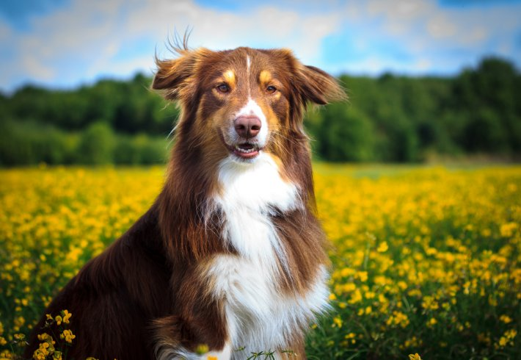
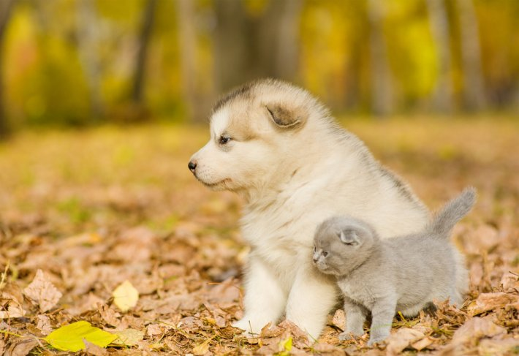
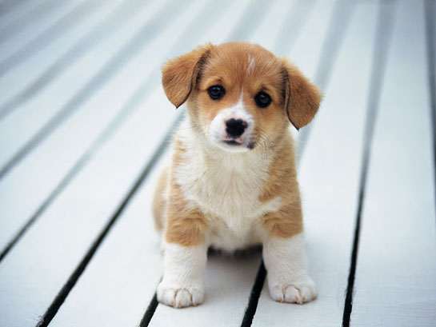


köpek
köpek
{dog, doggie}
~
Turkish
Turkish
English

Slide 4
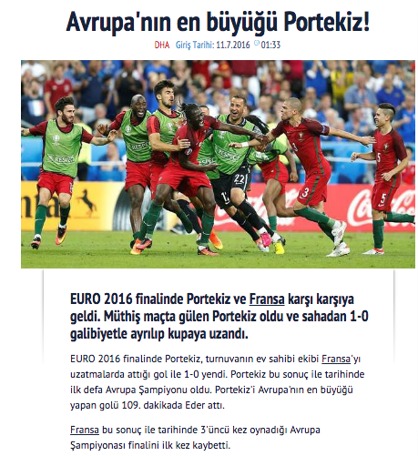
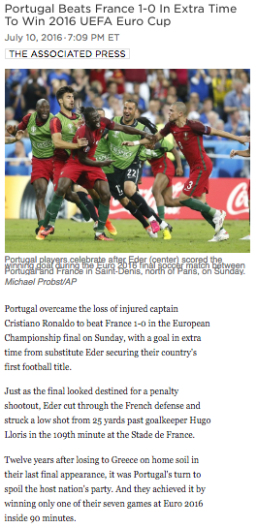
Turkish
English
Candidates
GPE: Portugal, France ...
ORG: Euro Cup ...
PER: Cristiano Ronaldo, Antoine Griezmann, Éder…
Image is a universal independent language!

Slide 5
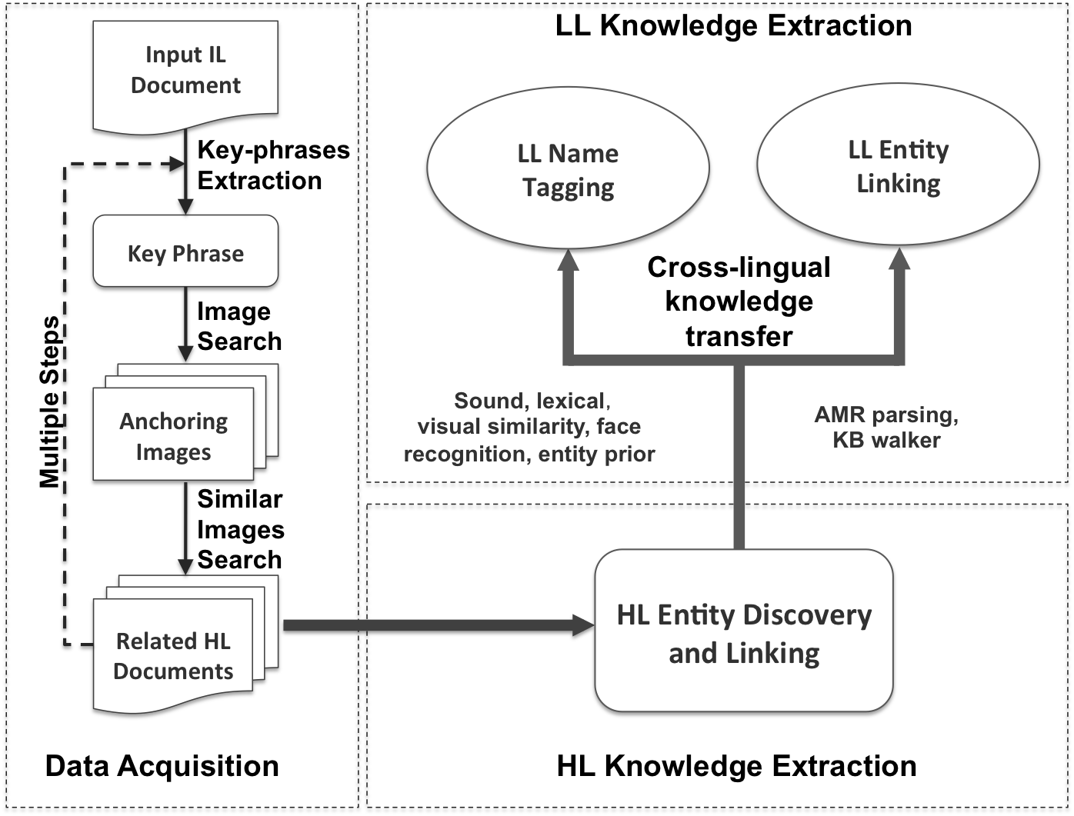
Overview

Slide 6
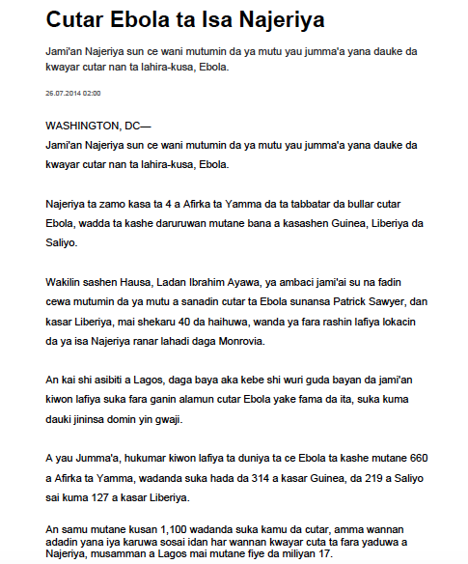
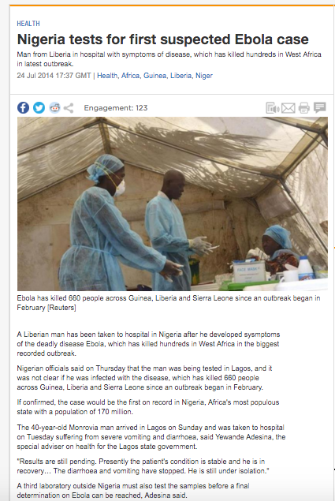
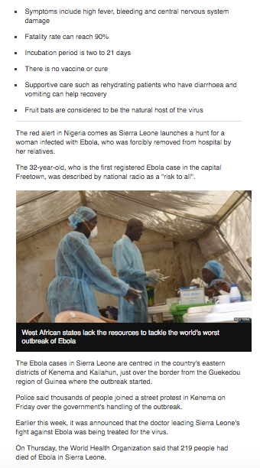








Input IL Document
HL Document Retrieval
Seed Image Retrieval
Language-Independent Key Phrase Extraction
TextRank (Mihalcea and Tarau, 2004)
  ‘hukumar sunansa’, ‘Patrick Najeriya’, ‘WASHINGTON’, ‘Ebola’
Topic modeling based on Latent Dirichlet allocation (LDA) model (Blei et al., 2003)
  ‘ebola cutar’, ‘mutumin’, ‘kwayar’, ‘guinea’, ‘lafiya’, ‘kiwon’, ‘najeriya’
The title of the document
  ‘Cutar Ebola ta Isa Najeriya’
Notes:
Language independent

Slide 7
Overview

Slide 8
HL Knowledge Extraction
Apply a state-of-the-art English name tagger (Li et al., 2014)
Apply a state-of-the-art Abstract Meaning Representation (AMR) parser (Wang et al., 2015a), and an AMR based entity linker (Pan et al., 2015)
Expand the Knowledge Base by:
  Entity prior (English Gigaword V5.0)
    When given a name
    ‘Gbagbo’ (Previous President of Côte d'Ivoire ) ~ ’Damana Picasse’ (official of the electoral body)
  KB walk (neighbors in KB)
Relation | Neighbor
Is founder of | SpaceX
Is founder of | Tesla Motors
Birth place | Pretoria
Alma mater | University of Pennsylvania
Parents | Errol Musk
Neighbors of Entity “Elon Musk”.
Notes:
examples

Slide 9
Overview

Slide 10
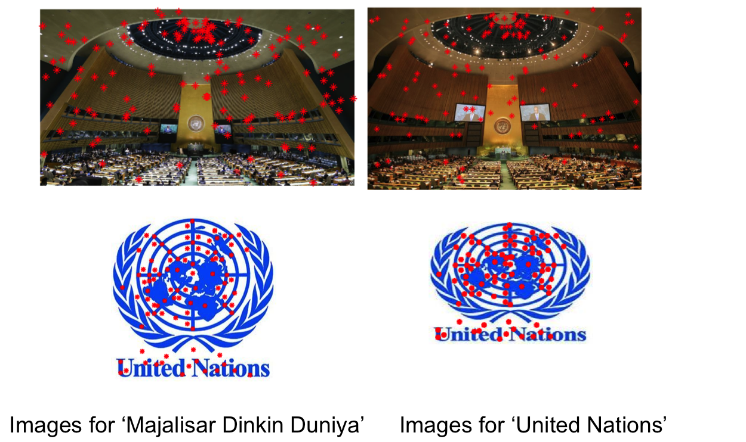
Case study 1: name tagging
Spelling (edit distance, substring)
  [Mogadishu]_{LOC} →[Mugadishu]_{LOC}
Pronunciation (Soundex, Metaphone, NYSIIS)
  [Najeriya]_{LOC}→[Nigeria]_{LOC}
  {N260, ['NJR', None], NAJARY} vs {N260, ['NJR', 'NKR'], NAGAR}
Visual Similarity: Scale-invariant feature transform (SIFT) detector (Lowe, 1999) to count key points
  Check if any two images share more than 10% key-points
Notes:
Rewrite the last bullet

Slide 11
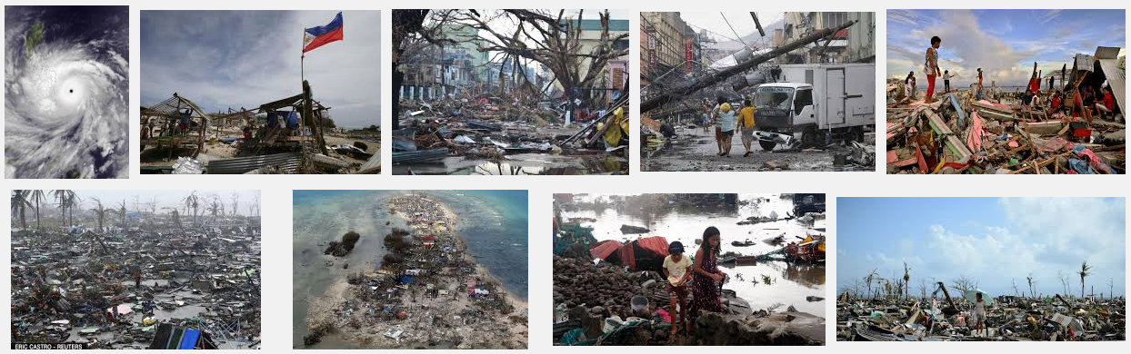
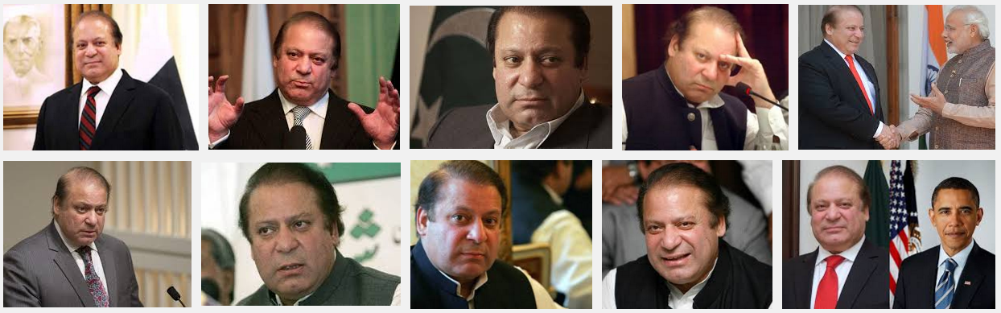
Case study 1: name tagging Cont.
Face detection: cascade classifiers based on Haar features
  “Haiyan”: Person → Not a name
  “…Karsa (country) Nawaz Shariff: Location → Person

Slide 12






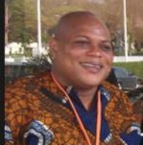

Cross-lingual Cross-media Knowledge Graphs
LOC: (Guinea) Guinea
LOC: (Nigeria) Najeriya
Part of
LOC: (Sierra Leone) Saliyo
Part of
Part of
Part of
LOC: (West Africa) Afirka ta Yamma
Part of
LOC: (Lagos) Lagos
LOC: (Liberia) Liberiya
Part of
Move To
PER: (Patrick Sawyer) Patrick Sawyer
LOC: (Monrovia) Monrovia
Move From
Notes:
Say more

Slide 13
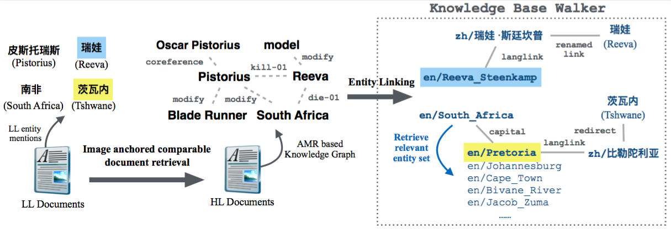


Case Study 2: Entity Linking
en/South Africa
capital
en/Pretoria
langlink
zh/比勒陀利亚
redirect
茨瓦内

Slide 14
Experiments
Name tagging
  30 Hausa documents from the DARPA LORELEI project
  63 persons, 64 organizations and 225 geo-political names and locations
  Baseline: Conditional Random Fields (CRFs) model trained from 337 documents
Entity linking
  30 Chinese documents from the TAC-KBP2015 Chinese-to-English Entity Linking track
  678 persons, 930 geo-political names, 437 organizations and 88 locations

Slide 15
Name Tagging Performance
95.00%
76.84%
67.06%
30.93%
Notes:
Add scores

Slide 16
Name Tagging Performance
 | Identification F-score |  |  |  | Classification Accuracy | Overall F-score
 | PER | ORG | LOC | ALL
Our Approach | 77.69 | 60.00 | 70.55 | 70.59 | 95.00 | 67.06
Our Approach w/o Visual Evidence | 73.77 | 46.58 | 70.74 | 67.98 | 94.77 | 64.43
Our Approach w/o Entity Prior | 64.91 | 60.00 | 70.55 | 67.59 | 94.71 | 64.02
Entity Prior can provide background information that are not mentioned in comparable documents
Visual Evidence can improve the organization score as well as person name accuracy

Slide 17
Entity Linking Performance
Approach | Overall |  |  |  |  | Linkable Entities
 | PER | ORG | GPE | LOC | ALL | PER | ORG | GPE | LOC | ALL
Baseline | 49.12 | 60.18 | 80.97 | 80.68 | 66.57 | 67.27 | 67.61 | 81.05 | 80.68 | 74.70
State-of-the-art(Ji et al., 2015) | 49.85 | 64.30 | 75.38 | 96.59 | 65.87 | 68.28 | 72.24 | 75.46 | 96.59 | 73.91
Our Approach | 52.36 | 67.05 | 93.33 | 93.18 | 74.92 | 71.72 | 75.32 | 93.43 | 93.18 | 84.06
Our Approach w/o KB Walker | 50.44 | 67.05 | 84.41 | 90.91 | 70.32 | 69.09 | 75.32 | 84.50 | 90.91 | 78.91
Confederate States of America
邦联
Confederation
.
.
.
Notes:
color

Slide 18
Conclusion and Future Work
Conclusion
  A multimedia approach to retrieve comparable documents
  Entity prior and KB walk to expand topic-related KB
  Transfer entity knowledge from high-resource languages to low-resource languages
Future Work
  Exploit visual pattern and concept detection to perform deep content analysis of the retrieved images

Slide 19
Thanks!

